Slide 1

IBM’s Deep Learning Professional Certificate
Course 1- Deep Learning Fundamentals with Keras
The demand for deep learning skills is continuing to grow, as AI becomes more pervasive in our societies. In this introductory course, you will learn about some of the inspiring and motivating applications of deep learning, you will learn about artificial neural networks and how they learn and optimize their parameters for a given task or application, and you will learn about deep learning models such as convolutional neural networks, recurrent neural networks and autoencoders. Finally, you will learn how to use the keras library to build different deep learning models.

Slide 2
Learning Objectives
In this course you will learn about:
Exciting applications of deep learning and why it is really rewarding to learn how to leverage deep learning skills
Neural networks and how most of the deep learning algorithms are inspired by the way brain functions and the neurons process data
How neural networks feed data forward through the network
The gradient descent algorithm and how variables are optimized with respect to a defined function
Backpropagation and how neural networks learn and update their weights and bias
The vanishing gradient problem
Activation functions
Deep learning libraries namely Keras, PyTorch, and TensorFlow
Building a regression and a classification model using the Keras library
Convolutional networks and how to build them using the Keras library
The difference between shallow and deep neural network
Recurrent Neural Networks and Autoencoders and how to build them using Keras.

Slide 3
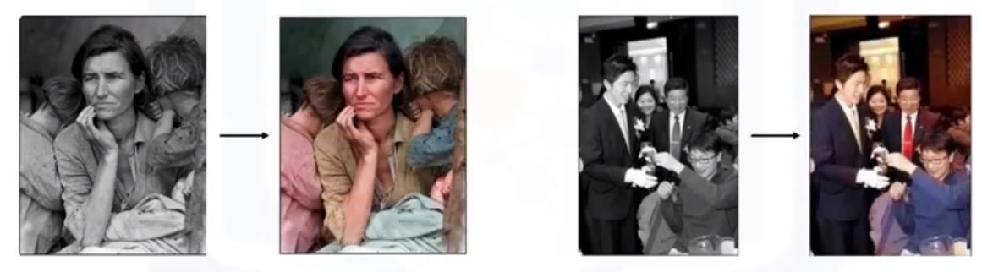
Module 1- Introduction to Deep Learning
1.1. Introduction to deep learning
Deep Learning is the hottest subject in data science
There is a lot of excitement about deep learning
I will share with you recent application to inspire you and to get you even more motivated
Color Restoration
Automatic colorization and color restoration in black and white images ( a grayscale image is automatically turned into a colored one). A group of researchers in Japan build a system using convolutional neural network that can take a grayscale image and add life to them by turning them into colored ones.

Slide 4
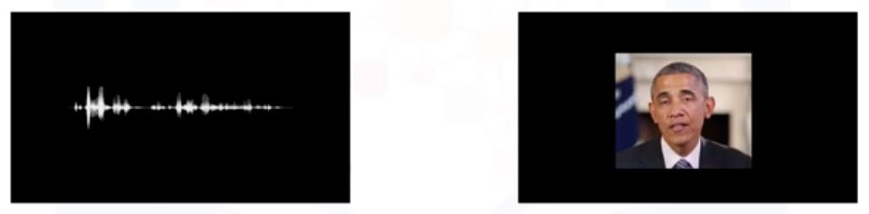
Speech Reenactment
Synching lip movements in a video with an audio clip. A group of researchers at the university of Washington built the first system that generated realistic results by training a recurrent neural network on a large corpus of video data of a single person. The subject of their case study is the President of the United States, Barack Obama.
From audio to video: here is an audio clip from one of Obama’s speeches. The audio clip synthetized with a video of one of his other speeches, and his lips movement were synced with the words and sounds in the audio clip.
From video to video: extracting an audio from a video and syncing the lip movements in other video with the audio from the first video.

Slide 5

Automatic Handwriting Generation
Alex Graves at the University of Toronto used a recurrent neural networks to design an algorithm that can rewrite a given message in highly realistic cursive handwriting in a wide variety of styles.

Slide 6
Other Applications
Automatic Machine Translation, where convolutional neural networks are used to translate text in an image on the fly.
Automatically Adding Sounds to Silent Movies, where a deep learning model uses a database of pre-recorded sounds to select a sound to play that best matches what is taking place in the scene.
Object Classification and Detection in Images.
Self Driving Cars

Slide 7
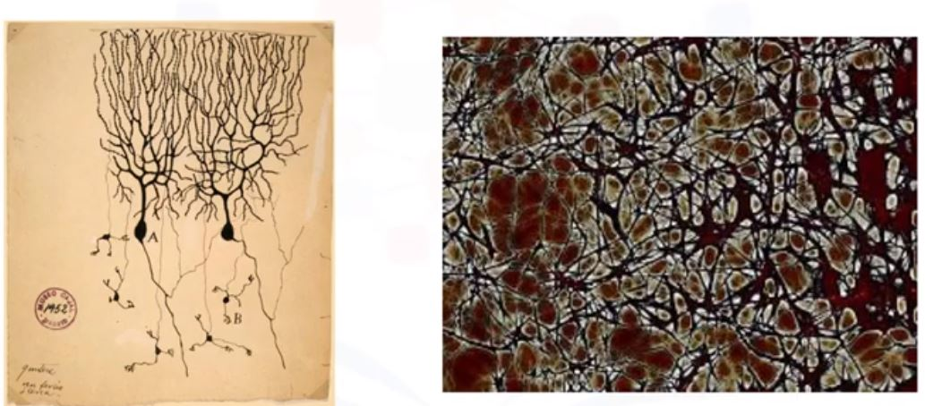
1.2. Neurons and Neural Networks
All the algorithms that are used in deep learning are largely inspired by the way neurons and neural networks function and process data in the brain.
The picture in the right was drawn by Snatigo Ramony Cajal, back in 1899 based on what he saw after placing a pigeon’s brain under the microscope. He is known as the father of modern neuroscience, but based on his drawing, the neurons, on of them labeled A, have big bodies in the middle of long arms that stretch out and branch off to connect with other neurons.

Slide 8
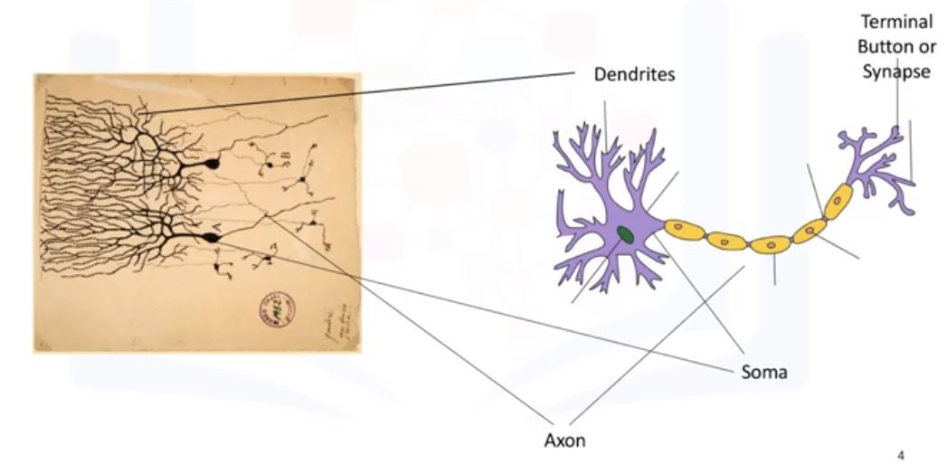
The dendrites receive electrical impulses which carry information, or data, from sensors or terminal buttons of the adjoining neurons. The dendrites then carry the impulses or data to the soma. In the nucleus, electrical impulses, or the data, are processed by combining them together, and then they are passed on the axon. The axon the carries the processed information to the terminal button or synapses, and the output of this neuron becomes the input to thousands of other neurons. Learning in the brain occurs by repeatedly activating certain neuron connections over others, and this reinforces those connections. This makes them more likely to produce a desired outcome given a specified input. Once the desired outcome occurs, the neural connections causing that outcome become strengthened.

Slide 9
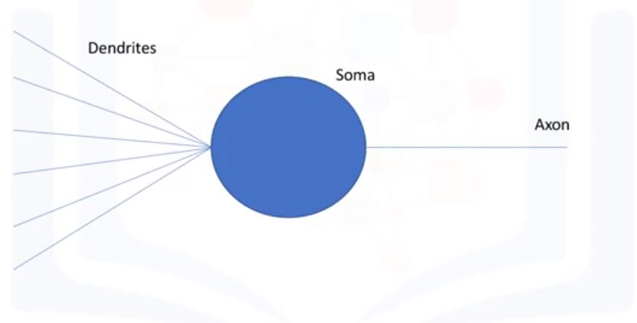
An artificial neuron behaves in the same way as a biological neuron. So it consists of soma, dendrites, and an axon to pass on the output of this neuron to the other neurons. The end of the axon can branch off to connect to many other neurons, but for simplicity we are just showing one branch here.

Slide 10
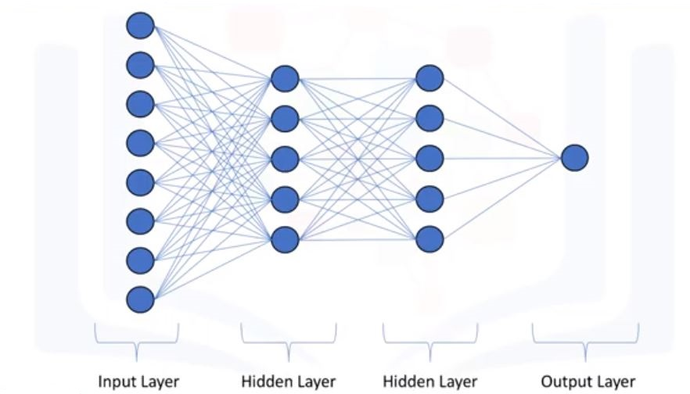
1.3. Artificial Neural Networks
In this video we will start learning about the mathematical formulation of neural networks.
When working with neural networks, the three main topics that we deal with are: forward propagation, backward propagation, and activation functions. The rest of the lesson will be mainly about forward propagation.

Slide 11
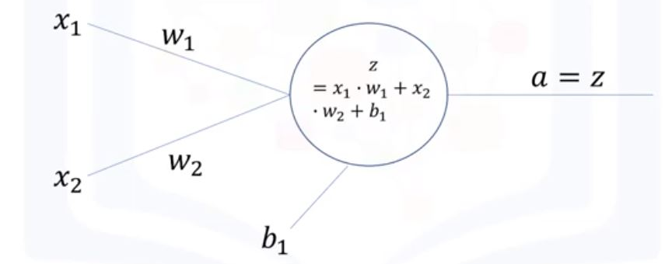
Forward Propagation
Forward propagation is the process through which data passes through layers of neurons in a neural networks from the input layer all the way to the output layer.
As shown here, the data flows through each neuron by connections or dendrites. Every connection has specific weight by which the flow of data is regulated. Here x1 and x2 are two inputs, they could be integer or float. When these inputs pass through the connections, they are adjusted depending on the connection weights, w1 and w2. The neuron then processes this information by outputting a weighted sum of these inputs. It also adds a constant to the sum which is referred to the bias. So z is the linear combination of the inputs and weights along with bias, and a is the output of the network

Slide 12
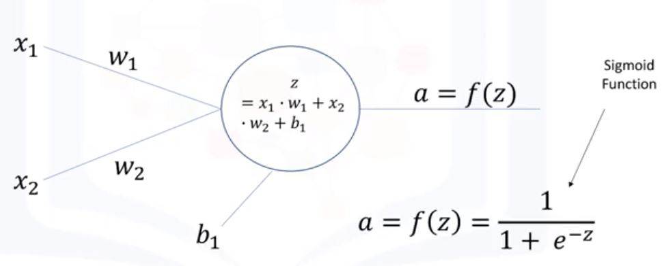
However, simply outputting a weighted sum of the inputs limits the tasks that can be performed by the neural network. Therefore, a better processing of the data would be to map the weighted sum to a nonlinear space.

Slide 13
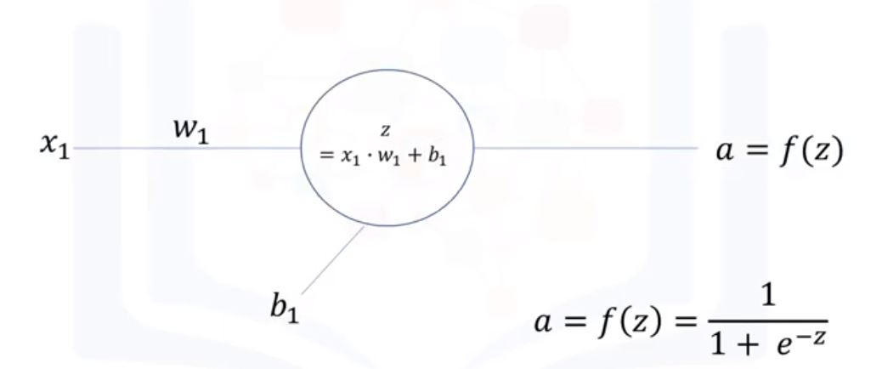
Nonlinear transformations like the sigmoid function are called activation functions. Activation functions are another extremely important feature of artificial neural networks. They basically decide whether a neuron should be activated or not. In other words, whether the information that the neurons receiving is relevant or should be ignored. The take away message here is that a neural network without an activation function is essentially just a linear regression model. The activation function performs nonlinear transformations to the input enabling the neural network of learning and performing more complex tasks, such as image classification.

Slide 14
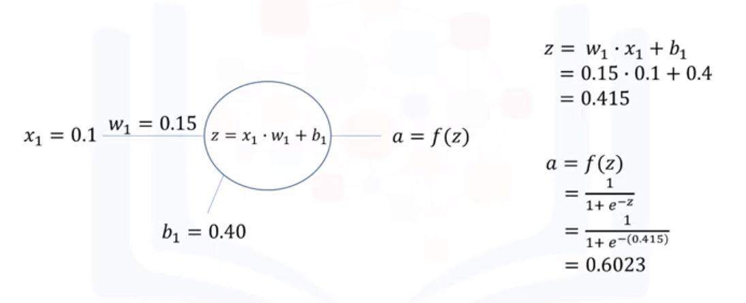

Slide 15
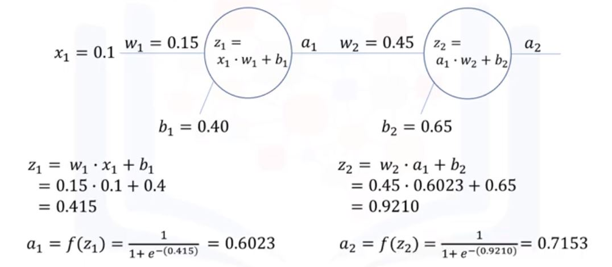

Slide 16
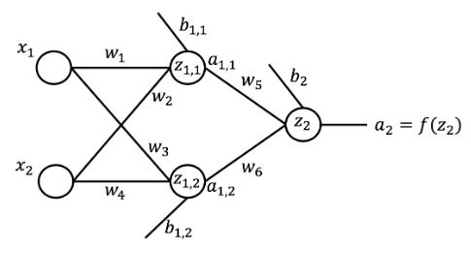
Lab: Artificial Neural Networks – Forward Propagation
In this lab, we will build a neural network from scratch and code how it performs predictions using forward propagation. Please note that all deep learning libraries have the entire training and prediction processes implemented, and so in practice you would not really need to build a neural network from scratch.
Let us start by randomly initializing the weights and the biases in the network. We have 6 weights and 3 biases, one for each node in the hidden layer as well as for each node in the output layer.

Slide 17
import numpy as np weights = np.around(np.random.uniform(size = 6), decimals=2) # intialize the weights biases = np.around(np.random.uniform(size = 3), decimals=2) # intialize the biases print(weights) print(biases)
[0.96 0.68 0.06 0.23 0.82 0.88]
[0.32 0.87 0.69]
Now that we have the weights and the biases defined for the network, let us compute the output for a given input $x_{1} and x_{2}$
x_1 = 0.5 x_2 = 0.85 print('x1 is {} and x2 is {}'.format(x_1,x_2))
Let us start by computing the weighted sum of the inputs, $x_{1,1} at the first node of the hidden layer$

Slide 18
z_11= x_1*weights[0]+ x_2*weights[1]+biases[0] print(‘The weighted sum of the inputs at the first node in the hidden layer is {}'.format(z_11))
The weighted sum of the inputs at the first node in the hidden layer is 1.25749
z_12= x_1*weights[2]+ x_2*weights[3]+biases[1] print('the weighted sum of the inputs at the second node in the hidden layer is {}'.format(z_12))
The weighted sum of the inputs at the second node in the hidden layer is 0.5255
Next assuming a sigmoid activation function, let us compute the activation of the first node $a_{1}$
a_11 = 1 / (1+ np.exp(-z_11)) print('The activation function of the first node in the hidden layer is {}'.format(a_11))
The activation function of the first node in the hidden layer is 0.7271

Slide 19
a_12 = 1 / (1+ np.exp(-z_12)) print('The activation function of the first node in the hidden layer is {}'.format(a_11))
The activation function of the first node in the hidden layer is 0.628
Now, these activations will serve as the inputs to the output layer. So, let us compute the weighted sum of these inputs to the node in the output layer.
z_2 = a_11*weights[4] + a_12*weights[5] + biases[2] print('the weighted sum of the inputs at the node in the output layer is {}'.format(z_2))
the weighted sum of the inputs at the node in the output layer is 0.6457
Finally, Let us compute the output of the network as the activation of the node in the output layer.
a_2 = 1/(1+np.exp(-z_2)) print('The output of the network for x1 = 0.5 and x2 = 0.85 is {}'.format(np.around(a_2, decimals=4)))
The output of the network for x1 = 0.5 and x2 = 0.85 is 0.7273

Slide 20
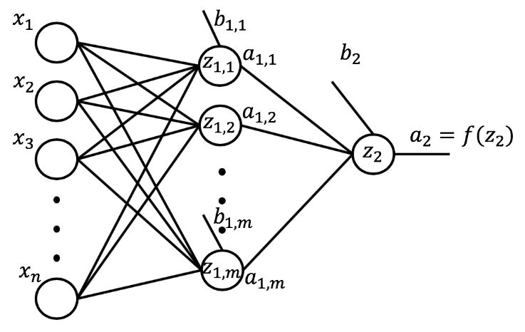
Obviously, neural networks for real problems are composed of many hidden layers and many more nodes in each layer. So, we cannot continue making predictions using this very inefficient approach of computing the weighted sum at each node and the activation of each node manually.
In order to code an automatic way of making predictions, let us generalize our network. A general network would take n inputs, would have many hidden layers, and would have an output layer. Although the network is showing one hidden layer, but we will code the network to have many hidden layers. Similarly, although the network shows an output layer with one node, we will code the network to have more than one node in the output layer.

Slide 21
Let us start by formally defining the structure of the network.
n = 2 #number of inputs num_hidden_layers = 2 m = [2,2] # number of nodes in each hidden layer num_nodes_output = 1 # number of nodes in the output layer
Now that we defined the structure of the network, let us go ahead and initialize the weights and the biases in the network to random numbers. In order to be able to initialize the weights and the biases to random numbers, we will need to import the Numpy library.

Slide 22
import numpy as np num_nodes_previous = n # number of nodes in the previous layer network = {} # initialize network as empty dictionary # loop through each layer and randomly initialize the weights and biases associated with each node # notice how we are adding 1 to the number of hidden layers in order to include the output layer for layer in range(num_hidden_layers + 1): # determine name of layer if layer == num_hidden_layers: layer_name = 'output' num_nodes = num_nodes_output else: layer_name = 'layer_{}'.format(layer+1) num_nodes = m[layer] # initialize weights and biases associated with each node in the current layer network[layer_name] = {} for node in range(num_nodes): node_name = 'node_{}'.format(node+1) network[layer_name][node_name]= { 'weights': np.around(np.random.uniform(size=num_nodes_previous), decimals=2), 'bias': np.around(np.random.uniform(size = 1), decimals = 2), } num_nodes_previous = num_nodes print(network)

Slide 23
{'layer_1': {'node_1': {'weights': array([0.78, 0.42]), 'bias': array([0.05])}, 'node_2': {'weights': array([0.38, 0.3 ]), 'bias': array([0.26])}}, 'layer_2': {'node_1': {'weights': array([0.68, 0.12]), 'bias': array([0.24])}, 'node_2': {'weights': array([0.76, 0.82]), 'bias': array([0.59])}}, 'output': {'node_1': {'weights': array([0.62, 0.64]), 'bias': array([0.29])}}}
Awesome ! So now with the above code, we are able to initialize the weights and the biases pertaining to any network of any number of hidden layers and number of nodes in each layer. But let us put this code in a function so that we are able to repetitively execute all this code whenever we want to construct a neural network.

Slide 24
import numpy as np
def initialize_network(num_inputs, num_hidden_layers, num_nodes_hidden, num_nodes_output): num_nodes_previous = num_inputs # number of nodes in the previous layer network = {} # loop through each layer and randomly initialize the weights and biases assocaiated with each layer for layer in range (num_hidden_layers + 1): if layer == num_hidden_layers: layer_name = 'output' # name last layer in the network output num_nodes = num_nodes_output else: layer_name = 'layer_{}'.format(layer + 1) # otherwise give the layer a number num_nodes = num_nodes_hidden[layer] # initialize weights and bias for each node network[layer_name] = {} for node in range(num_nodes): node_name = 'node_{}'.format(node+1) network[layer_name][node_name] = { 'weights': np.around(np.random.uniform(size = num_nodes_previous), decimals = 2), 'bias': np.around(np.random.uniform(size=1), decimals=2), } num_nodes_previous = num_nodes return network
print(initialize_network(5, 3, [3, 2, 2], 1))

Slide 25
{'layer_1': {'node_1': {'weights': array([0.97, 0.16, 0.77, 0.19, 0.6 ]),
'bias': array([0.87])},
'node_2': {'weights': array([0.17, 0.48, 0.9 , 0.63, 0.76]),
'bias': array([0.31])},
'node_3': {'weights': array([0.37, 0.17, 0.89, 0.83, 0.2 ]),
'bias': array([0.79])}},
'layer_2': {'node_1': {'weights': array([0.33, 0.6 , 0.01]),
'bias': array([0.14])},
'node_2': {'weights': array([0.56, 0.54, 0.77]), 'bias': array([0.07])}},
'layer_3': {'node_1': {'weights': array([0.55, 0.75]), 'bias': array([0.62])},
'node_2': {'weights': array([0.7 , 0.82]), 'bias': array([0.29])}},
'output': {'node_1': {'weights': array([0.43, 0.35]), 'bias': array([0.11])}}}

Slide 26
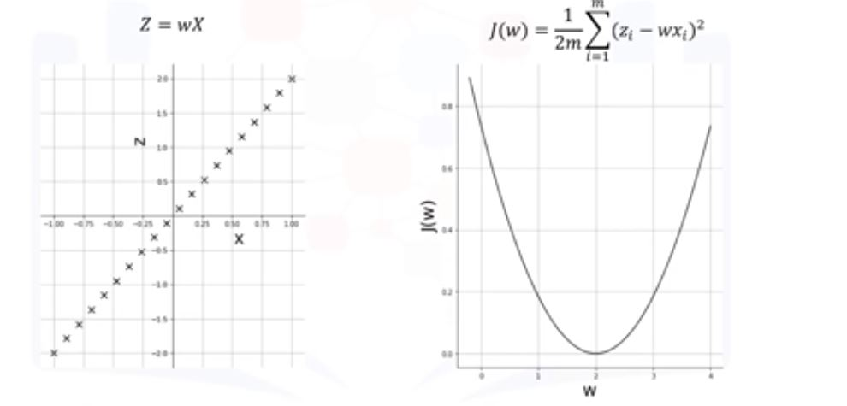
Module 2- Artificial Neural Networks
2.1. Gradient Descent
Gradient Descent is an iterative optimization algorithm for finding the minimum of a function. To find the minimum of a function using gradient descent, one takes steps proportional to the negative of the gradient of the function at the current point.

Slide 27
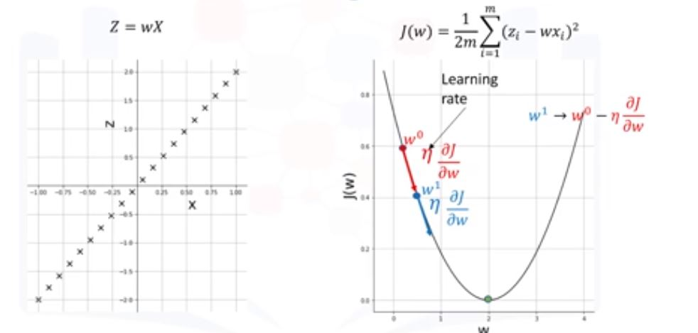

Slide 28
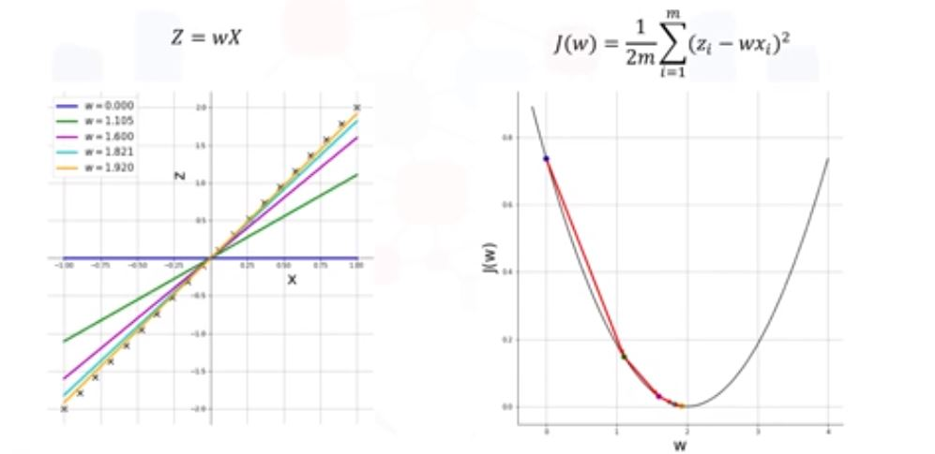

Slide 29
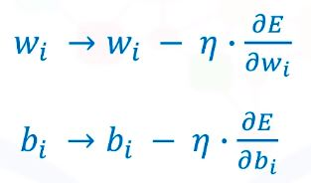
2.2. Backpropagation
How do neural network train and optimize their weights and biases for a given problem and data set? Training is done in a supervised learning setting, where each data point has a corresponding label and ground truth. And training is needed when the predicted value by the neural network obviously does not match the ground truth for a given input.
Backpropagation Algorithm
Calculate the error between the ground truth and the estimated output. Let us denote the error by E. This error now represents the cost or the loss function.
Propagate this error back into the network and update each weight and bias as per the following equations.

Slide 30
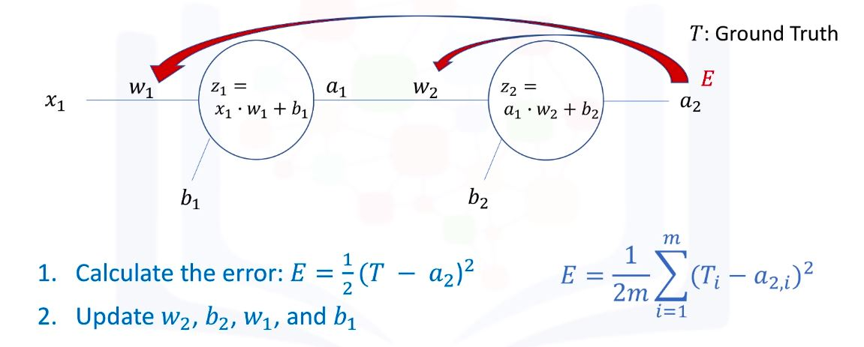

Slide 31
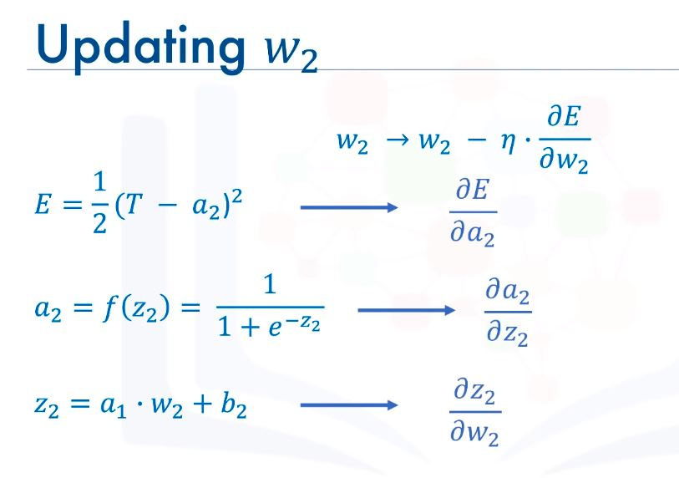

Slide 32
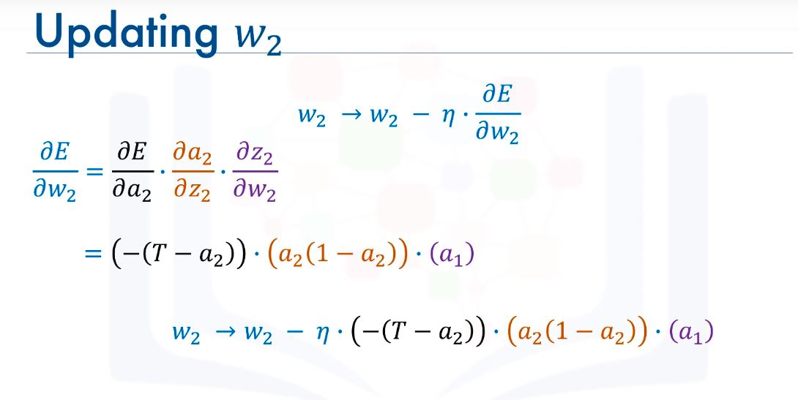

Slide 33
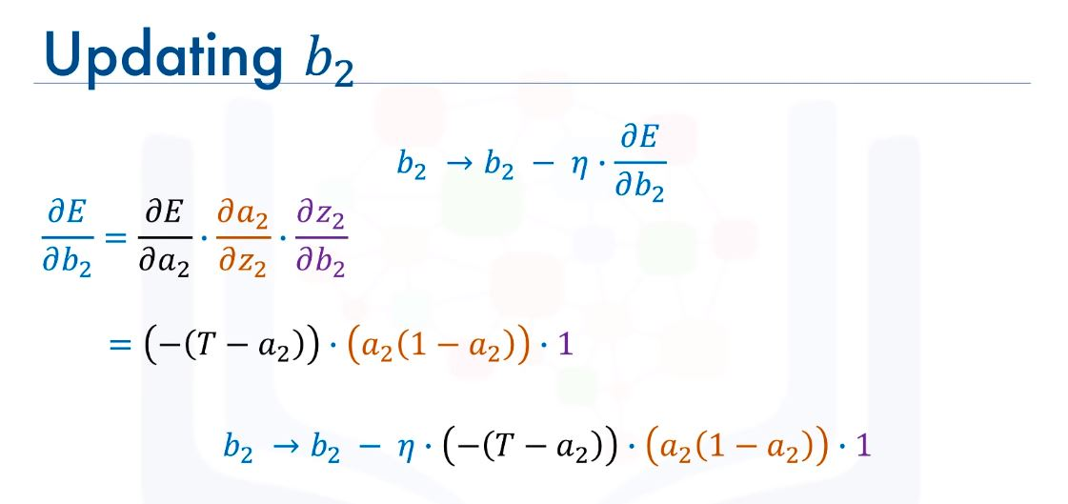

Slide 34
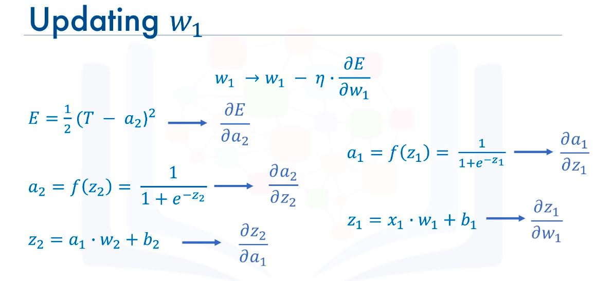

Slide 35
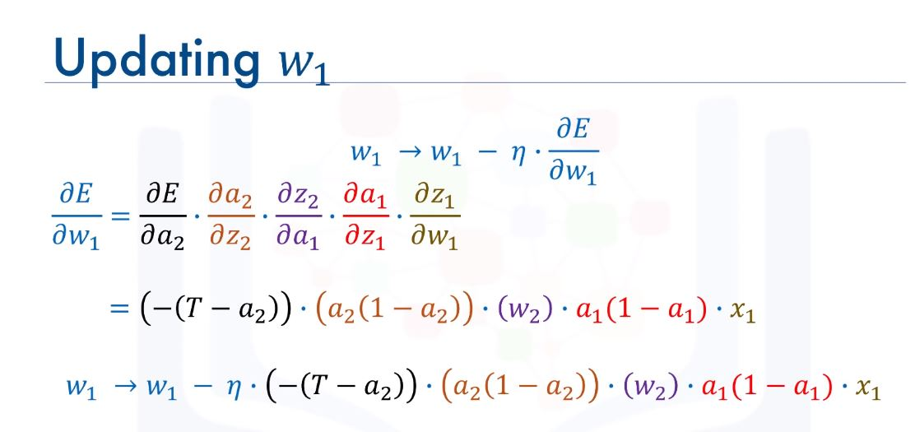

Slide 36
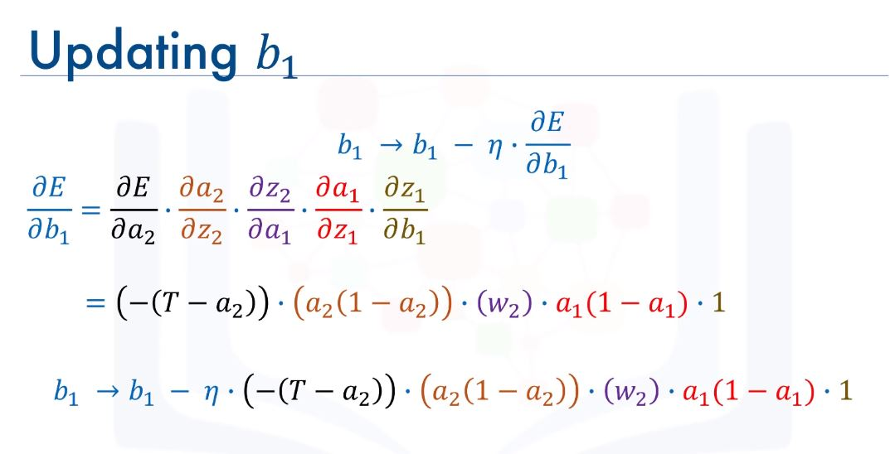

Slide 37
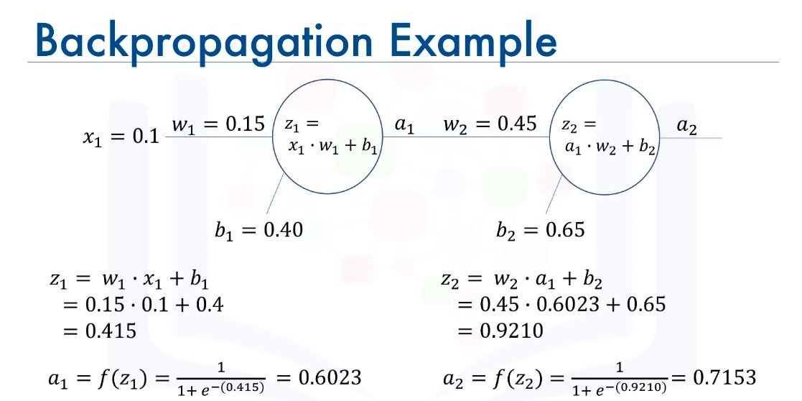

Slide 38
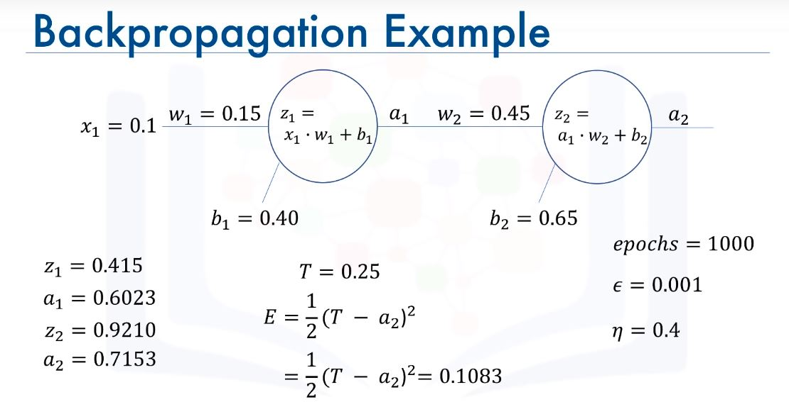

Slide 39
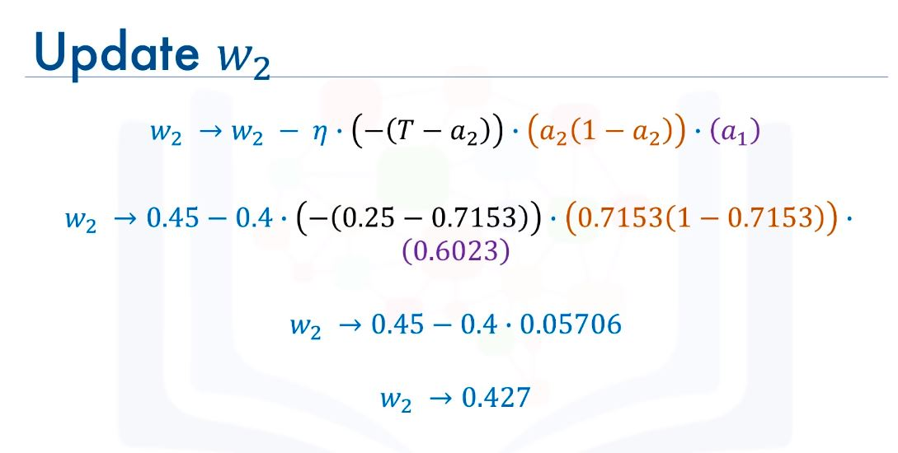

Slide 40
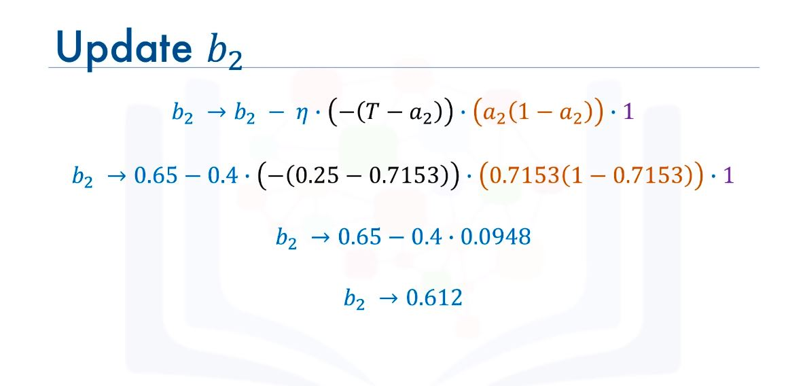

Slide 41
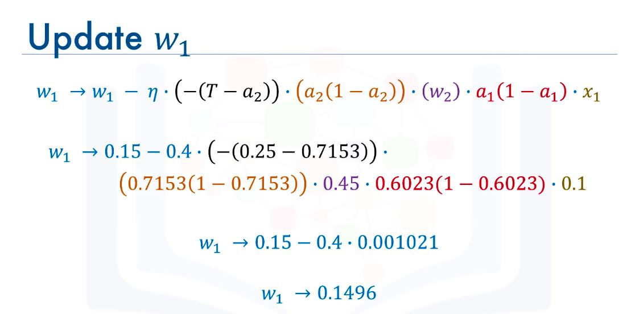

Slide 42
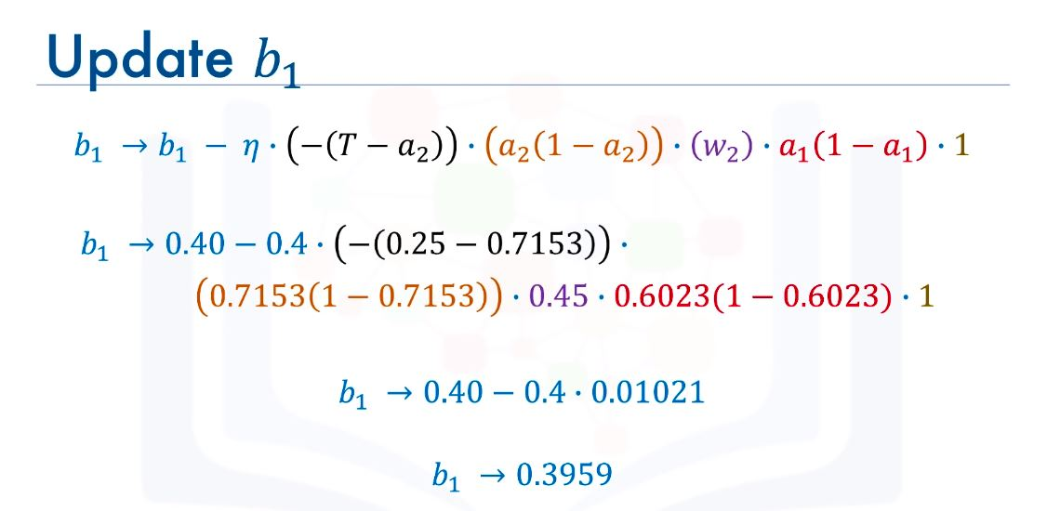
This completes the first iteration or epoch of the training process. With the updated weights and biases, we do another round of full propagation calculate predicted value and compare it to the ground truth. Calculate the error and do another round of backpropagation.

Slide 43
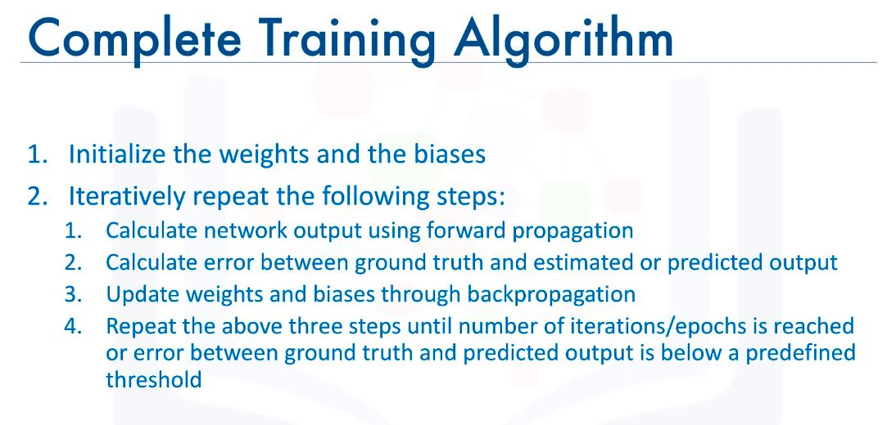

Slide 44
2.3. Vanishing Gradient
In this lesson we will discuss a problem with the sigmoid activation function that prevented neural networks from blooming sooner. This problem is the vanishing gradient descent. Recall from the last video, with a very simple network of 2 neurons only, the derivatives of the error with respect to the weights re very small, but more importantly how small the gradient of the error with respect to w1.
It turns out that because we are using the sigmoid function as the activation function, then all the intermediate values in the network are between 0 and 1. so when we do backpropagation, we keep multiplying factors that are less than 1 by each other, and so their gradient tend to get smaller and smaller as we keep on moving backward in the network. This means that the neurons in the earlier layers learn very slowly as compared to the neurons in the later layers in the network. The earlier layer in the network are the slowest to train. The result is a training process that takes too long and a prediction accuracy that is compromised.
Accordingly, this is the reason why we do not use the sigmoid function or similar functions as activation functions, sine they are prone to the vanishing gradient problem.

Slide 45
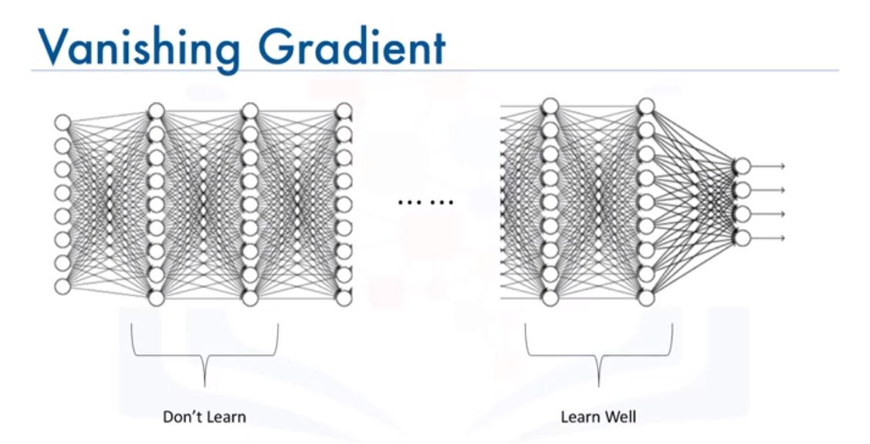

Slide 46
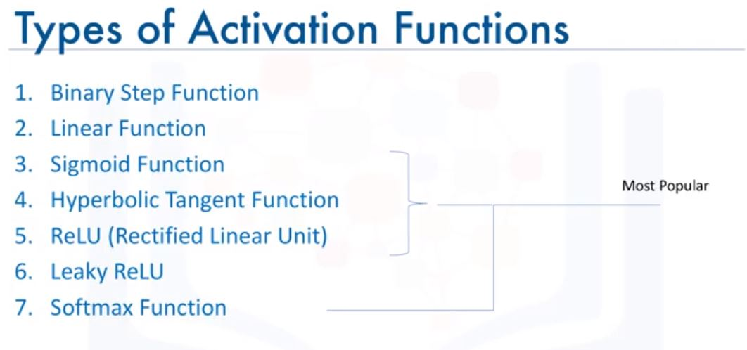
2.4. Activation Functions

Slide 47
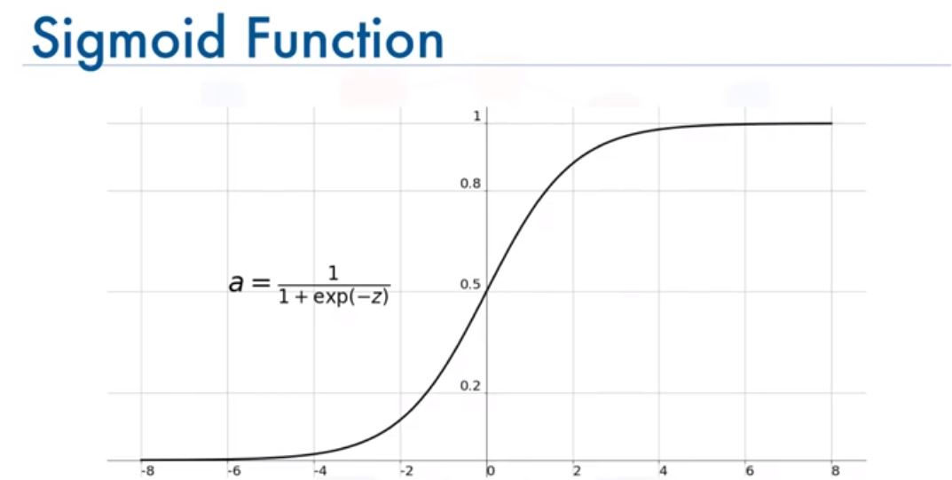
Sigmoid functions used to be widely used as activation functions in the hidden layers of a neural network. However, as you can see, the function is pretty flat beyond the +3 and -3 region. This means that once the function falls in that region, the gradient become very small. This results in the vanishing problem that we discussed, and the gradients approach 0, the network does not really learn. Another problem with the sigmoid function is that the values only range from 0 to 1. This means that the sigmoid function is not symmetric around the origin. The values going to the next neuron be all of the same sign. This can be addressed by scaling the sigmoid function and this bring us to the hyperbolic function.

Slide 48
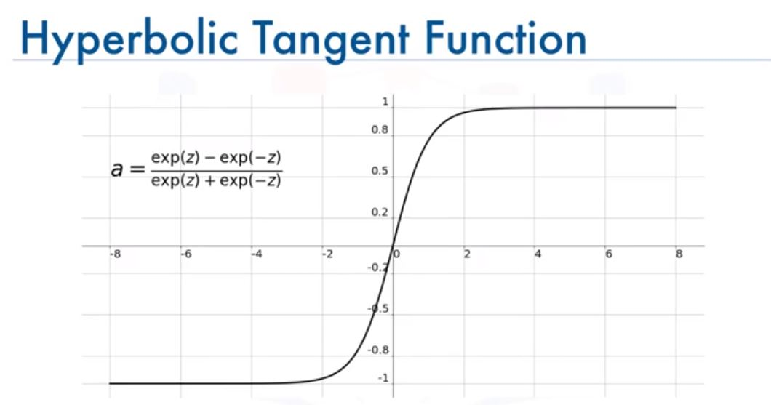
This function is a scaled version of the sigmoid function, but unlike the sigmoid function, it is symmetric over the origin. It ranges from -1 to +1. however, although it overcomes the lack of symmetry of the sigmoid function, it also leads to the vanishing gradient problem in very deep neural networks.

Slide 49
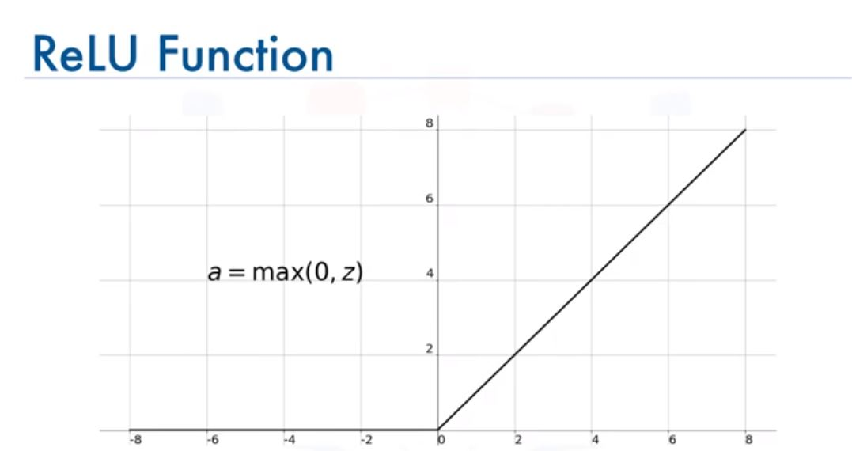
The ReLU function is the most widely used activation function when designing neural networks today. In addition to it being nonlinear, the main advantage of using the ReLU function over the other activation functions is that it does not activate all the neurons at the same time. According to the plot, if the input is negative it will be converted to 0, and the neuron does not get activated. This means that at a time, only a few neurons are activated.

Slide 50
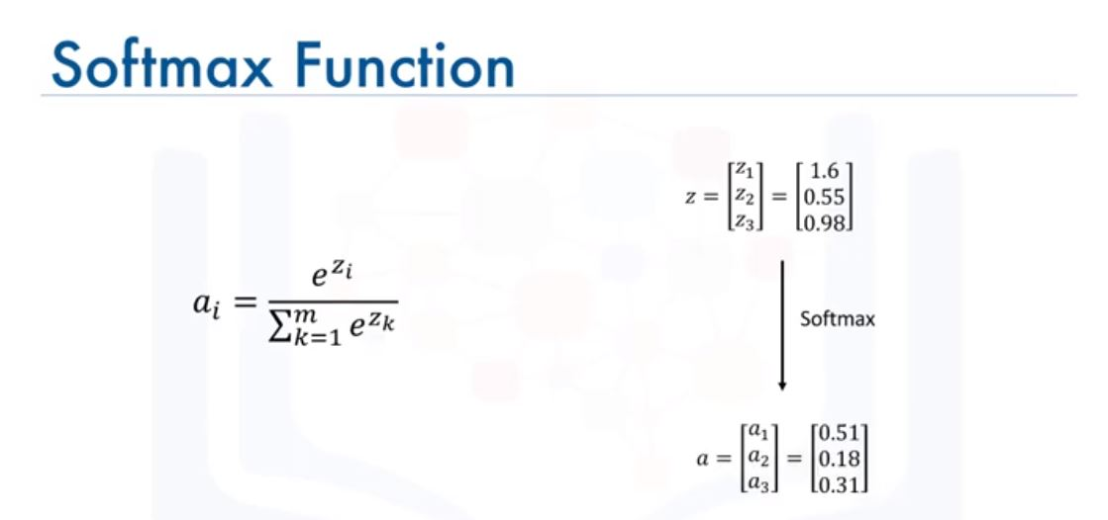
The softmax function is also a type of a sigmoid function, but it is handy when we are trying to handle classification problems. The softmax function is ideally used in the output layer of the classifier where we are actually trying to get the probabilities to define the class of each input.

Slide 51
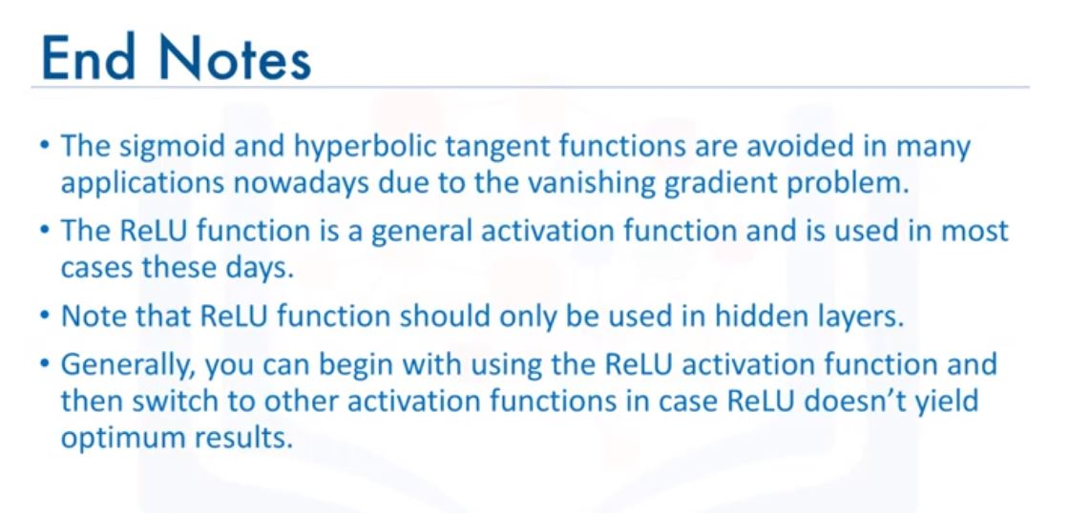

Slide 52

Module 3- Keras and Deep Learning Libraries
3.1. Deep Learning Libraries
Theano is a library developed by the Montreal Institute for Learning Algorithms, and was the major library for deep learning development even before TensorFlow and PyTorch. However, the founder can’t afford to continuously support it and maintain it, and therefore the library lost its popularity.

Slide 53
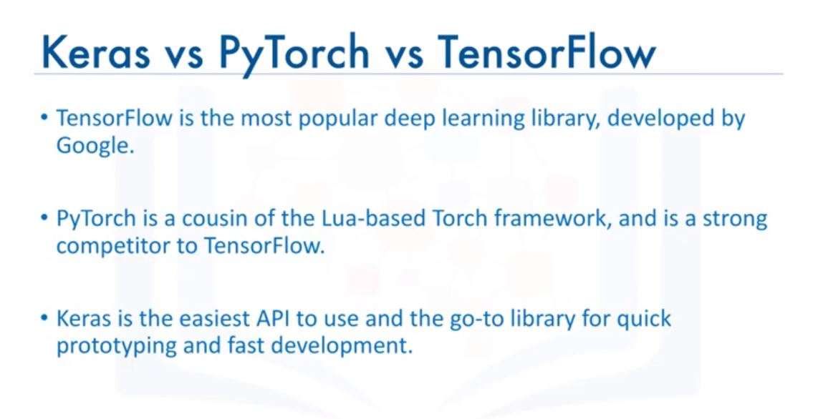

Slide 54
Among the three TensorFlow is the most popular library. It is the library that is mostly used in production of deep learning models. It has a very large community. Just a quick look at the number of forks on the library’s GithHub repository as well as the number of commits and pull requests should sufficient giving you an idea of how popular the library is. TensorFlow was developed by Google and released to the public in 2015, and is still being actively used at Google for both research and production needs.
PyTorch on the other hand, is the cousin of the Torch framework, which is in Lua, and supports machine learning algorithms running on GPUs in particular. However, being derived from the Torch framework, PyTorch is just a set of wrappers to support a popular language like Python. It was actually rewritten and tailored to be fast and feel native. PyTorch was released in 2016 and has gained immense interest lately and is becoming the preferred language over TensorFlow, especially in academic research and applications of deep learning requiring optimizing custom expressions. PyTorch is supported and actively used by Facebook. However, despite their popularity, both PyTorch and tensorFlow are not easy to use, and have a steep learning curve.
Keras normally runs on top of a low-level library such as TensorFlow. This means that to be able to use the Keras library, you will have to install TensorFlow first, and when you import Keras, it will be explicitly displayed what backend was used to install the Keras library.

Slide 55
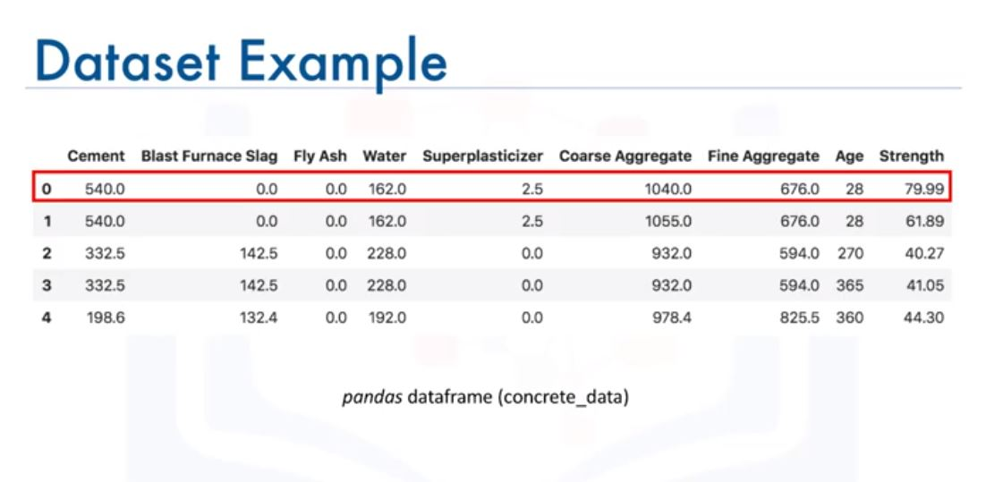
3.2. Regression Models with Keras

Slide 56
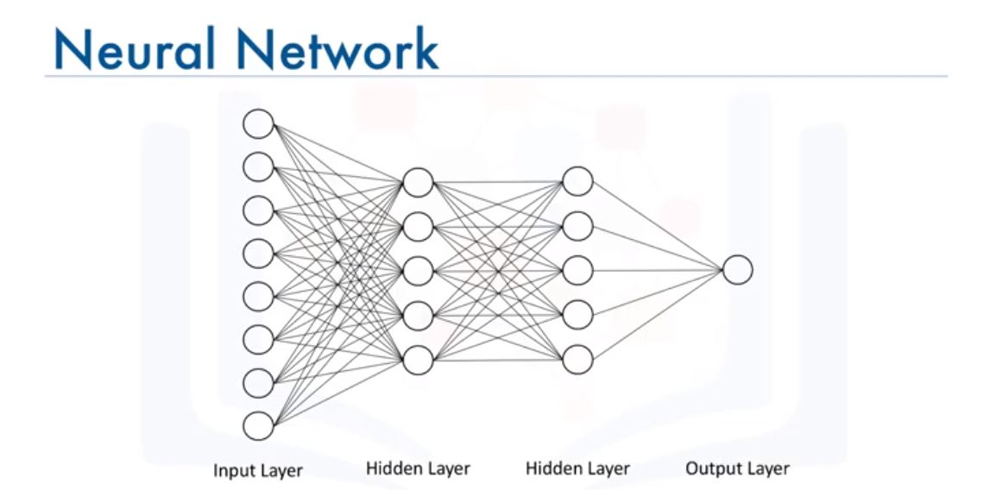
Notice how all the nodes in one layer are connected to all the other nodes in the next layer. Such a network is called a dense network.

Slide 57
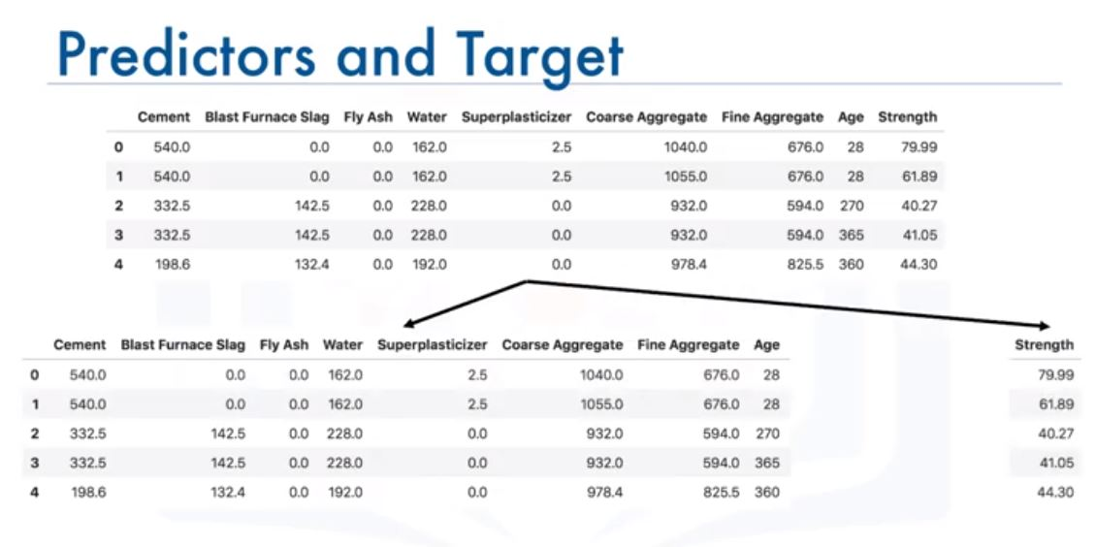

Slide 58
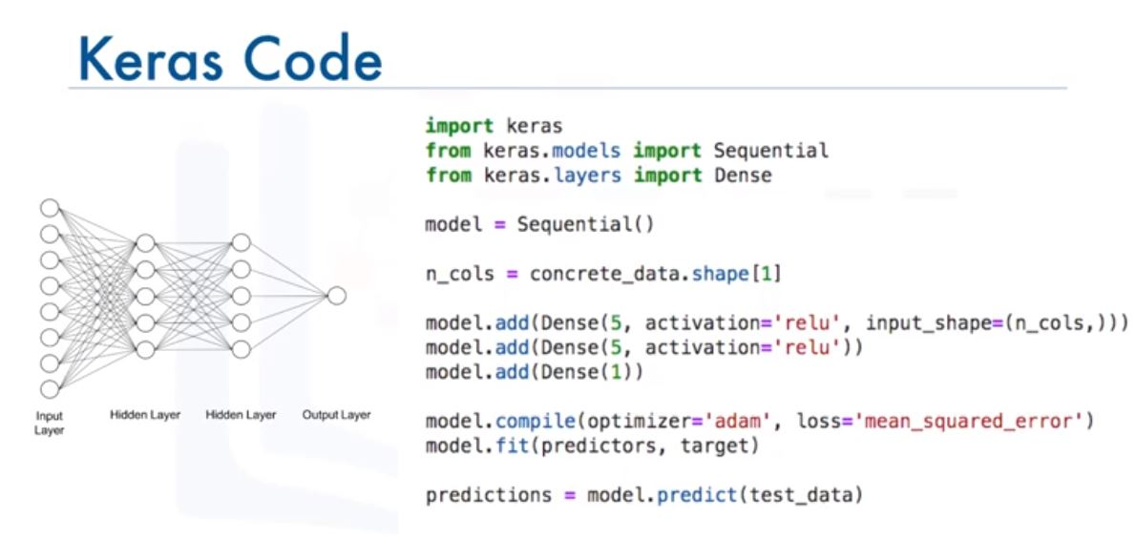
As for the minimization algorithms, there are actually other more efficient algorithms than the gradient descent for deep learning applications. One of them is “adam”. One of the main advantages of the “adam” optimizer is that you do not need to specify the learning rate that we saw in the gradient descent video.

Slide 59
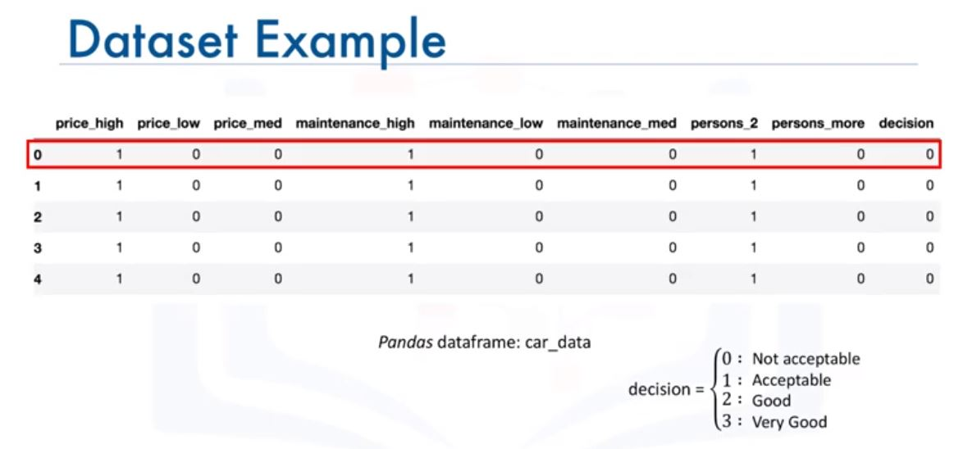
3.3. Classification Models with Keras

Slide 60
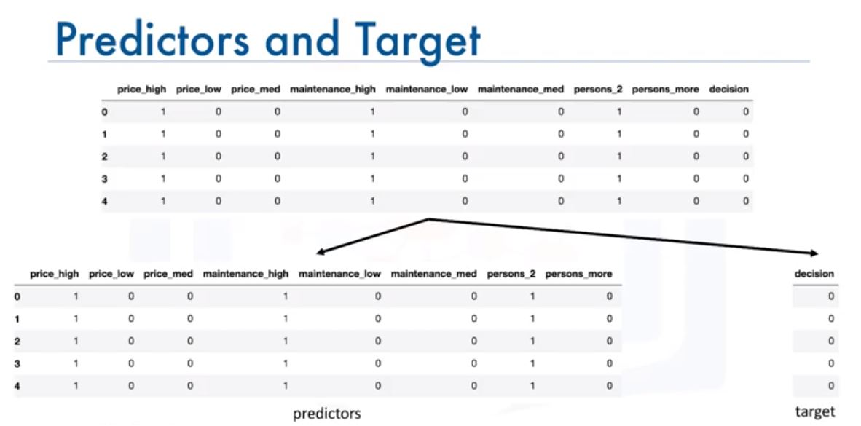

Slide 61
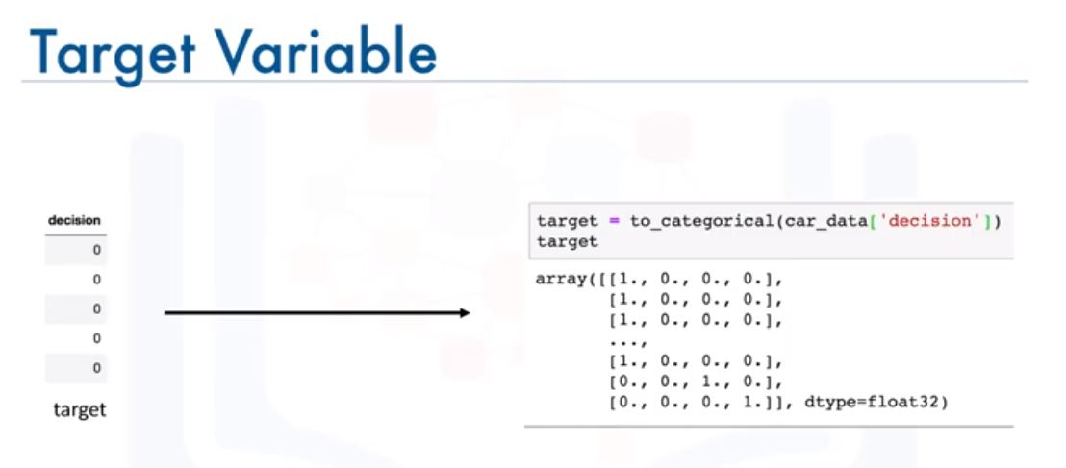

Slide 62
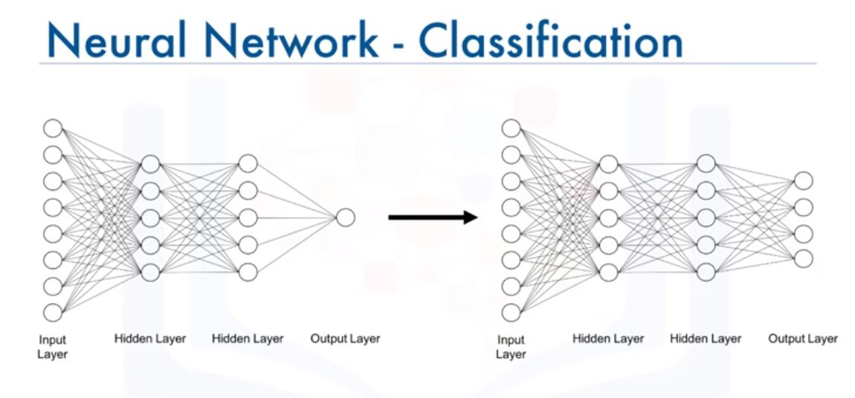

Slide 63
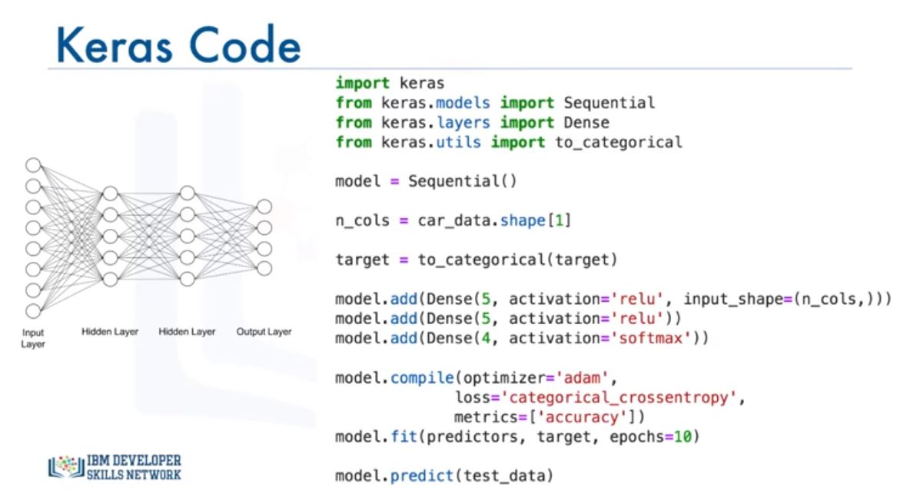

Slide 64
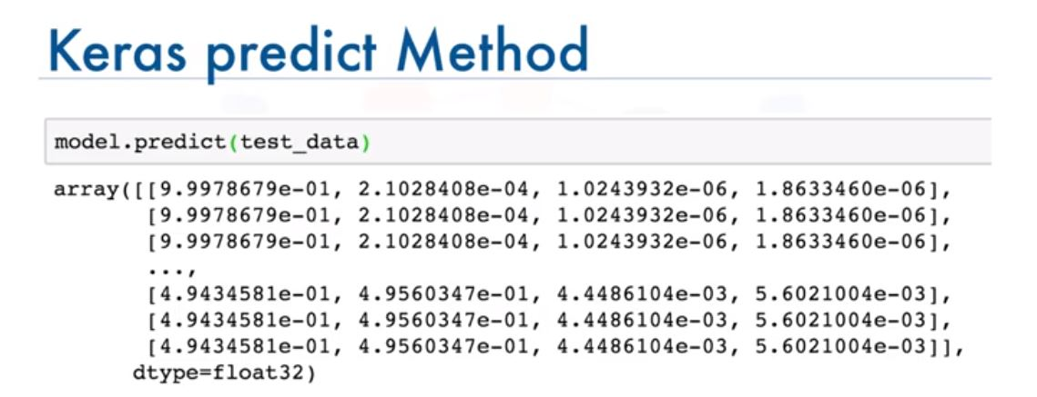
For each data point the output is the probability that the decision of purchasing a given car belongs to one of the four classes. For each data point, the probabilities should sum to 1, and the higher the probability the more confident is the algorithm that a data point belongs to the respective class. So for the first data point or the first car in the test set, the decision would be 0 meaning not acceptable, since the first probability is the highest, with a value of 0.99 or close to 1, in this case. For the last three data points, the decision would be 1 or acceptable, since the probabilities for the second class are higher than the rest of the classes.

Slide 65
Lab: Regression Models with Keras
# Download and Clean Dataset import pandas as pd import numpy as np concrete_data = pd.read_csv('https://ibm.box.com/shared/static/svl8tu7cmod6tizo6rk0ke4sbuhtpdfx.csv') print(concrete_data.head()) print(concrete_data.shape) print(concrete_data.describe)
(1030, 9)
concrete_data_columns = concrete_data.columns predictors = concrete_data[concrete_data_columns[concrete_data_columns != 'Strength']] target = concrete_data['Strength'] print(predictors.head()) print(target.head()) predictors_norm = (predictors - predictors.mean()) / predictors.std() n_cols = predictors_norm.shape[1] # number of predictors

Slide 66
import Keras from Keras.models import Sequential from Keras.layers import Dense # Build a Neural Network def regression_model(): # create model model = Sequential() model.add(Dense(50, activation = 'relu', input_shape(n_cols, ))) model.add(Dense(50, activation = 'relu')) model.add(Dense(1)) model = regression_model() model.fit(predictors_norm, target, validation_split=0.3, epochs=100, verbose = 2)

Slide 67
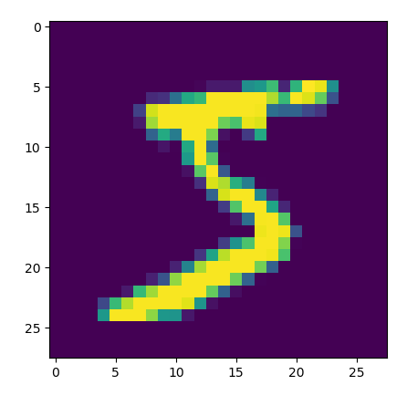
Lab: Classification Models with Keras
# Import Keras and Packages import tensorflow as tf import keras from keras.models import Sequential from keras.layers import Dense from keras.utils import to_categorical import matplotlib.pyplot as plt from keras.datasets import mnist # Read the data (X_train, y_train), (X_test, y_test) = mnist.load_data() print(X_train.shape) plt.imshow(X_train[0])
(60000, 28, 28)

Slide 68
With conventional neural networks, we cannot feed in the image as input as is. So we need to flatten the images into one-dimensional vectors, each of size 1 x (28x28) = 1 x 784
# flatten images into one-dimensional vector num_pixels = X_train.shape[1]*X_train.shape[2] #Find size of 1-D vector X_train = X_train.reshape(X_train.shape[0], num_pixels).astype('float32') #flatten training images X_test = X_test.reshape(X_test.shape[0], num_pixels).astype('float32') #flatten test images
Since pixel values can range from 0 to 255, let us normalize the vectors to be between 0 and 1.
# normalize inputs from 0-255 to 0-1 X_train = X_train/255 X_test = X_test/255
Finally, before we start building our model, remember that for classification we need to divide our target variable into categories. We use the to_categorical function from the keras Utilities package.

Slide 69
# one hot encode outputs y_train = to_categorical(y_train) y_test = to_categorical(y_test) num_classes = y_test.shape[1] print(num_classes)
10
# Define classification model def classification_model(): model = Sequential() model.add(Dense(num_pixels, activation='relu', input_shape=(num_pixels, ))) model.add(Dense(100, activation='relu')) model.add(Dense(num_classes, activation='softmax')) model.compile(optimizer='adam', loss = 'categorical_crossentropy', metrics=['accuracy']) return model # Train and Test the Network model = classification_model() model.fit(X_train, y_train, validation_data=(X_test, y_test), epochs=10, verbose=2) scores = model.evaluate(X_test, y_test, verbose=0) print('Accuracy: {}% \n Error: {}'.format(scores[1], 1 - scores[1]))

Slide 70
Train on 60000 samples, validate on 10000 samples
Epoch 1/10
- 15s - loss: 0.1815 - accuracy: 0.9448 - val_loss: 0.0922 - val_accuracy: 0.9716
Epoch 2/10
- 15s - loss: 0.0784 - accuracy: 0.9749 - val_loss: 0.0785 - val_accuracy: 0.9755
Epoch 3/10
- 15s - loss: 0.0525 - accuracy: 0.9831 - val_loss: 0.0823 - val_accuracy: 0.9762
Epoch 4/10
- 16s - loss: 0.0411 - accuracy: 0.9870 - val_loss: 0.0650 - val_accuracy: 0.9803
Epoch 5/10
- 17s - loss: 0.0298 - accuracy: 0.9904 - val_loss: 0.0757 - val_accuracy: 0.9799
Epoch 6/10
- 16s - loss: 0.0274 - accuracy: 0.9909 - val_loss: 0.1020 - val_accuracy: 0.9760
Epoch 7/10
- 16s - loss: 0.0222 - accuracy: 0.9927 - val_loss: 0.0813 - val_accuracy: 0.9781
Epoch 8/10
- 16s - loss: 0.0202 - accuracy: 0.9935 - val_loss: 0.0753 - val_accuracy: 0.9827
Epoch 9/10
- 16s - loss: 0.0167 - accuracy: 0.9947 - val_loss: 0.0945 - val_accuracy: 0.9794
Epoch 10/10
- 16s - loss: 0.0157 - accuracy: 0.9952 - val_loss: 0.0818 - val_accuracy: 0.9826
Accuracy: 0.9825999736785889%
Error: 0.017400026321411133

Slide 71
Just running 10 epochs could actually take over 2 minutes. But enjoy the results as they are getting generated.
Sometimes, you cannot afford to retrain your model everytime you want to use it, especially if you are limited on computational resources and training your model can take a long time. Therefore, with the Keras library, you can save your model after training. To do that, we use the save method.
model.save('classification_model.h5')
Since our model contains multidimensional arrays of data, then models are usually saved as .h5 files.
When you are ready to use you model again, you use the load_model function from keras.models
from keras.models import load_model pretrained_model = load_model('classification_model.h5')

Slide 72

Module 4- Deep Learning Models
4.1. Shallow versus Deep Neural Networks
Unlike shallow neural network which takes only input as vectors, deep neural network are able to take raw data such as image and text and automatically extract the necessary features to learn the data better.

Slide 73


Slide 74
The sudden boom in the deep learning field can be attributed to three main factors. Number 1, advancement in the field itself. We talked about this briefly in the activation function video, where we mentioned that the ReLU activation function helped overcome the challenge of the vanishing gradient problem, and therefore, opened the door to the creation of very deep networks. Therefore, advancement in the field itself is one factor that helped deep learning take off. Another main reason is the availability of data. Deep neural networks work best when trained with large amounts of data, since neural networks learn the training data so well, then large amounts of data have to be used in order to avoid overfitting of the data so well. And finally with NVIDIA’s superpowerful GPUs, we are now able to train very deep neural network on tremendous amount of data in a matter of hours as opposed to days or weeks, which is how long it used to take to train very deep neural networks.

Slide 75

4.2. Convolutional Neural Networks
CNNs make the explicit assumptions that the inputs are images, which allow us to incorporate certain properties into their architecture. These properties make the forward propagation step much more efficient and vastly reduces the amount of parameters in the network.

Slide 76


Slide 77

So far, we have dealt only with conventional neural networks that take an (n x 1) vector as their input. The input to a convolutional neural network, on the other hand, is mostly an
(n x m x 1) for grayscale image or an (n x m x 3) for colored images, where the number 3 represents the red, green, and blue components of each pixel in the image.

Slide 78


Slide 79


Slide 80


Slide 81
In the convolutional layer, we basically define filters and we compute the convolution between the defined filers and each of the three images. If we take the red image for example, let us assume these are the pixels values. Now for a 2 x 2 filter with these values, let us create an empty matrix to save the results of the convolution process. We start by sliding the filter over the image and computing the dot product between the filter and the overlapping pixel values and storing the result in the empty matrix. We repeat this step moving our filter one cell, or one stride is the proper terminology, at a time, and we repeat this until we cover the entire image and fill the empty matrix. Here I just showed one filter and only one of the three images. The same thing would be applied to the green and blue images and you can apply more than one filter. The more filters we use the more we are able to preserve the spatial dimensions better.
Why would we need to use convolution? Why not flatten the input image into an (n x m) x 1 vector and use that as our input? Well, if we do that, we will end up with a massive number of parameters that will need to be optimized, and it will be super computationally expensive. Also decreasing the number of parameter would definitely help in preventing the model from overfitting the training data. It is worth mentioning that a convolutional layer also consists of ReLU’s which filter the output of the convolutional step passing only positive values and turning any negative values to 0.

Slide 82


Slide 83


Slide 84
The next layer in our convolutional neural network is the pooling layer. The pooling layer’s main objective is to reduce the spatial dimensions of the data propagating through the network. There are two type of pooling that are widely used in convolutional neural networks. Max pooling and average pooling. In max pooling which is the most common of the two, for each section of the image we scan we keep the highest value.
Similarly with average pooling we compute the average of each area we scan. In addition to reducing the dimension of the data, pooling, or max pooling in particular, provides spatial variance which enables neural network to recognize objects in an image even if the object does not exactly resemble the original object.

Slide 85

In the fully connected layer, we flatten the output of the last convolutional layer and connect every node of the current layer with every other node of the next layer. This layer basically takes as input the output from the preceding layer, whether is a convolutional layer, ReLU, or pooling layer, and outputs an n-dimensional vector where n is the number of classes pertaining to the problem at hand. For example, if you are building a network to classify images of digits, the dimension n would be 10, since there are 10 digits.

Slide 86


Slide 87
After defining the input shape to be a tuple of (128, 128, 3) we start adding layers to the network. We start with a convolutional layer, with 16 filters, each filter being of size 2x2 and slides through the image with a stride of magnitude 1 in the horizontal direction, and of magnitude 1 in the vertical direction. And the layer uses the ReLU activation function. Then we add a pooling layer and we are using max-pooling here with a filter or pooling size of 2 and the filter slides through the image with a stride of magnitude 2. then we add another set of convolutional and pooling layers. The only difference here is we are using more filters in the convolutional layer, actually twice as many filters as the first convolutional layer. Finally, we flatten the output from these layers so that the data can proceed to fully connected layers. We add another dense layer with 100 nodes and an output layer that has nodes equal to the number of classes in the problem at hand. And we use the softmax activation function in order to convert the output into probabilities.

Slide 88

4.3. Recurrent Neural Networks

Slide 89
RNN is a supervised deep neural network.
So far, we have seen neural networks and deep learning models that see data points independent instances. However, let us say you want to build a model that can analyze scenes in a movie. Well, you cannot assume that scenes in a movie are independent, and therefore, traditional deep learning models are not suitable for this application. RNN overcome this issue. RNN, are networks with loops that do not just take a new input at a time, but also take in as input the output from the previous data point that we fed into the network. Essentially, we can start with a normal neural network. At time t=0, the network takes in inputs x0 and output a0. then at time t1, in addition to the input x1, the network also takes a0 as input, weighted with w0,1 and so on, and so forth. As a result RNN are very good at modelling patterns and sequences of data, such as texts, genomes, handwriting, and stock markets. These algorithms take time and sequence into account, which means that they have a temporal dimension.

Slide 90


Slide 91

4.4. Autoencoders
Autoencoding is a data compression algorithm where the compression and the decompression functions are learned automatically from data. Instead of being engineered by a human. Such autoencoders are built using neural networks. Autoencoders are data specific, which means that they will only be able to compress data similar to what they have been trained on.

Slide 92

Some interesting applications of autoencoders are data denoising and dimensionality reduction for data visulazations. Autoencoder takes an image, as an input and uses an encoder to find the optimal compressed representation of the input image. Then, using a decoder the original image is restored. This algorithm uses backpropagation by setting the target variable to be the same as the input. In other words, it tries to learn an approximation of an identity function.

Slide 93


Slide 94
Lab: Artificial Neural Networks – Forward Propagation
In this lab, we will build a neural network from scratch and code how it performs predictions using forward propagation. Please note that all deep learning libraries have the entire training and prediction processes implemented, and so in practice you would not really need to build a neural network from scratch.
Let us start by randomly initializing the weights and the biases in the network. We have 6 weights and 3 biases, one for each node in the hidden layer as well as for each node in the output layer.

